Slide 1
Digital Marketing Strategy Roadmap
Developing Digital Marketing Strategy Roadmap
Business strategy for digital
Customer development strategy
Digital marketing mix strategy
Digital marketing implementation strategy

Slide 2
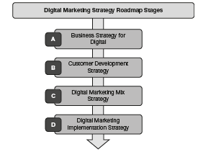

Slide 3
The digital marketing strategy roadmap stages include:
Business strategy for digital
Factors impacting digital strategy
Firms strategic intent
Core competency alignment

Slide 4
(b) Customer development strategy
Segmentation 2.0
Targeting 2.0
Positioning 2.0
(c) Digital marketing mix strategy
Classic 4Ps
Extended 4Ps
(d) Digital marketing implementation strategy

Slide 5
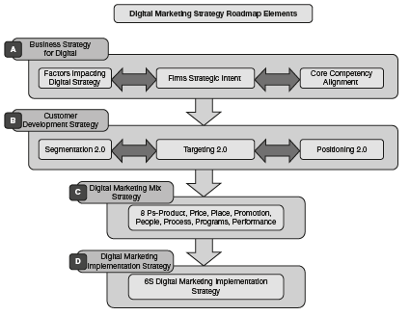

Slide 6
The 6S Digital Marketing Implementation Strategy
Stage DS1 (Digital Scoping)
Stage DS2 (Digital Shadow)
Stage DS3 (Digital Set-up)
Stage DS4 (Digital Stability)
Stage DS5 (Digital Scale-up)
Stage DS6 (Digital Spectrum)

Slide 7
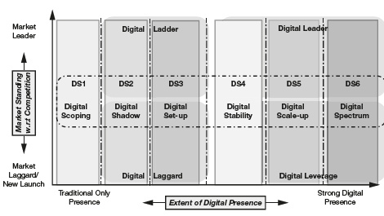

Slide 8
PLC Concept—Marketing across the Product Life Cycle
Product launch/development phase
Product growth/enhancement phase
Product maturity phase/decline phase
Product sunset phase/termination phase

Slide 9
